Slide 1



CREDIT
ALLOTMENT MODEL
MILINDH R KASHYAP
PRASHATH TALWAR

Slide 2

INTRODUCTION
Financial institutions face challenges in assessing creditworthiness for individuals with limited or no credit history.
Opportunistic individuals strategically default, exploiting the information void.
Our machine learning model fills this void by providing nuanced creditworthiness appraisal.
Aims to help businesses make informed lending decisions, maximizing revenue and minimizing defaults.
Offers expedited application processing for efficient customer service.

Slide 3

GOAL
Harness available data to offer an advanced risk assessment tool for financial institutions.
Analyze traditional and alternative credit indicators to predict loan default likelihood.
Enable informed lending decisions, minimizing the risk of bad loans and setting interest rates based on credit history.
Reduce loan application turnaround time, helping eligible borrowers receive loans promptly.

Slide 4
METHODOLOGY

Slide 5
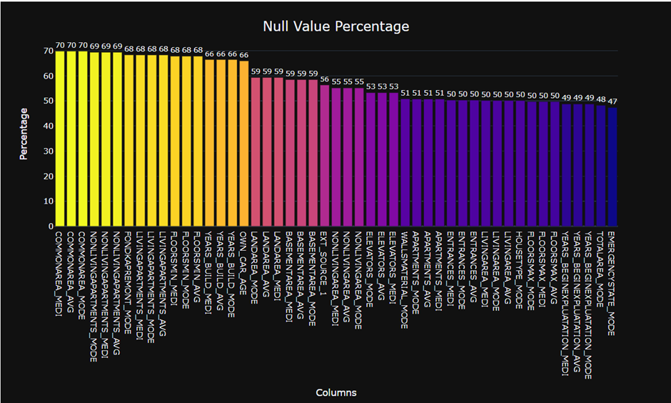
Methodolgy includes processing the data, conducting explorartory analysis and choosing the model to base our project on
Extensive data processing, including null value removal and feature analysis.
Utilization of three distinct methods: Logistic Regression, Decision Trees, and Random Forests.
Comparison of results to build the best-suited model while addressing underfitting and overfitting.

Slide 6
After analysing the data, we go though the features with null values to see which has the most null values
These are some of the features with highest amount of null values. We analyse the columns that have nul values more than 45

Slide 7
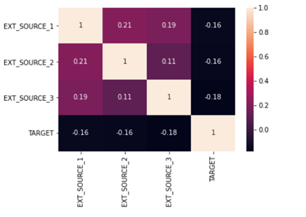
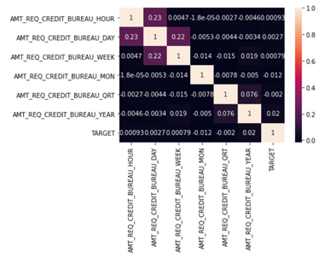
To make sense of all the features we use correlation amtrix to compare the features with the TARGET feature.
The features that do not have any correlation are removed from the DataFrame

Slide 8
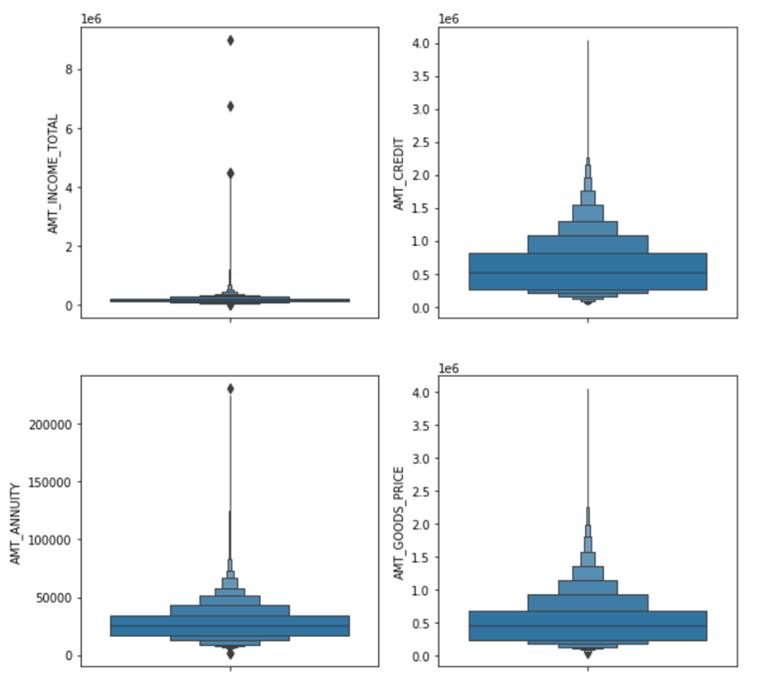
We not check for the outliers and remove some of the outliers in the columns

Slide 9
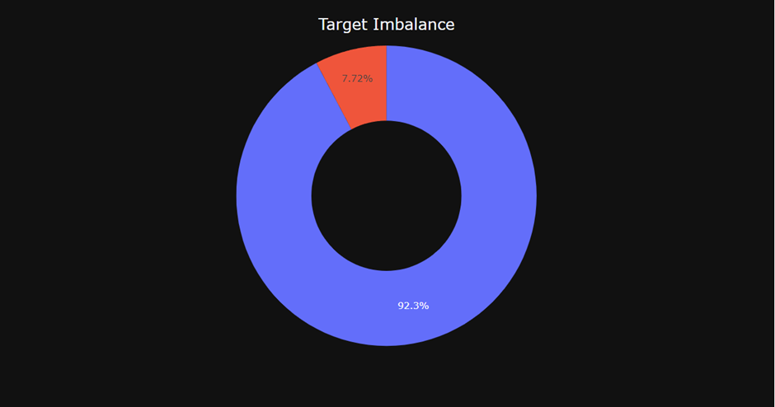
TARGET IMBALANCE
- Train a machine learning model with the TARGET variable as the target array.
- Objective: Achieve high accuracy.
- Initial model performance: 85% accuracy.
- Closer inspection revealed a significant problem with false positives.
- Found a substantial imbalance in the TARGET column.
- 92% of the data corresponded to 0, and only 8% to 1.
- Recognized the adverse impact of class imbalance on model performance.
- Took deliberate steps to address the imbalance in the dataset.
- Incorporated crucial values from an additional CSV file related to the application data.
- Enriched dataset to better capture underlying patterns and relationships.
- Trained a refined machine learning model.
- Objective: Strike a balance between sensitivity and specificity.

Slide 10
ANALYSIS AND RESULTS

Slide 11
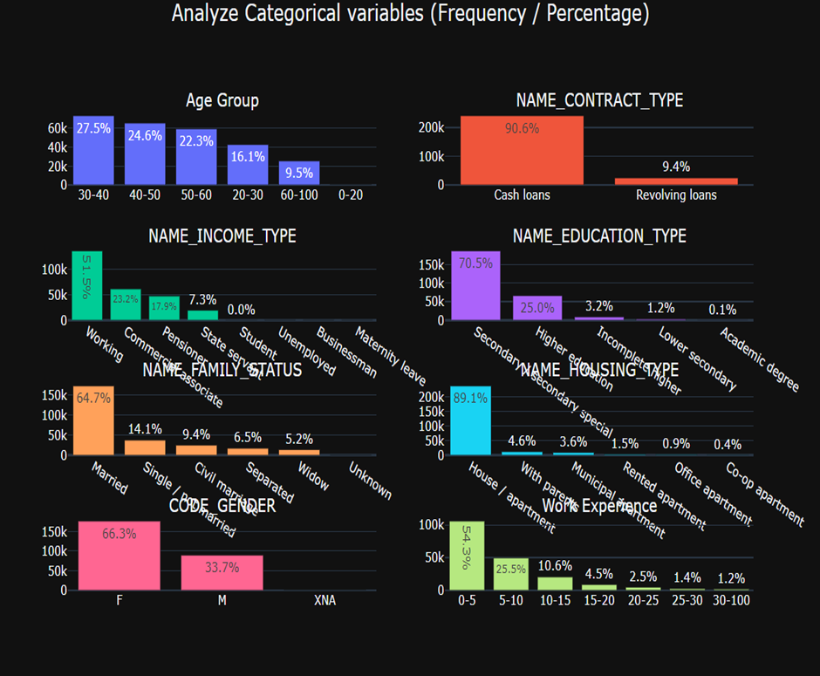
Analysis
We take all the features into consideration and analyse information from every feature.
We analyse the percentage of the data in all the columns
The analysis shows us key findings such as how many applications have come from a certain age group or which working class has the highest number of applications.

Slide 12
Analysis
We use the same features that we used in the previous slide to make a difference between the defaulters and repayers
From this plot we can see that applicants with academic degrees do not fall into the defaulters category. Or the customers who take cash loans are most likely to default their loans

Slide 13
MACHINE LEARNING

Slide 14
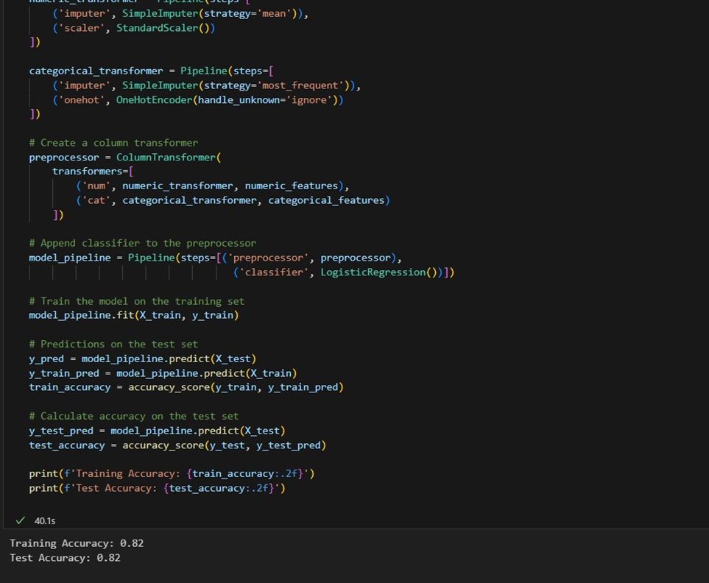
LOGISTIC REGRESSION
As spoken earlier we use Logistic regression to train the binary output here with this data.
The model has an accuracy of 82% which can be increased even more with more powerful models.
This is a classic example of how this dataset is a little too big for a model like logistic regression

Slide 15
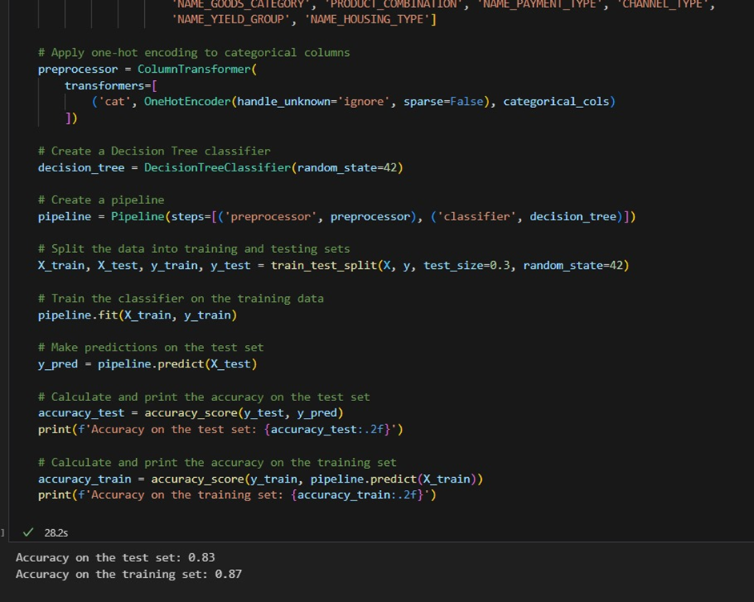
DECISION TREE
Decision tree is a machine learning model used for both classification and regression tasks
As the data is a binary classifier data, we thought Decision tree was the best model that we could use.
As the data traverses the tree the decision is made with respect to the features
We get 87% accuracy for our model with decision tree

Slide 16
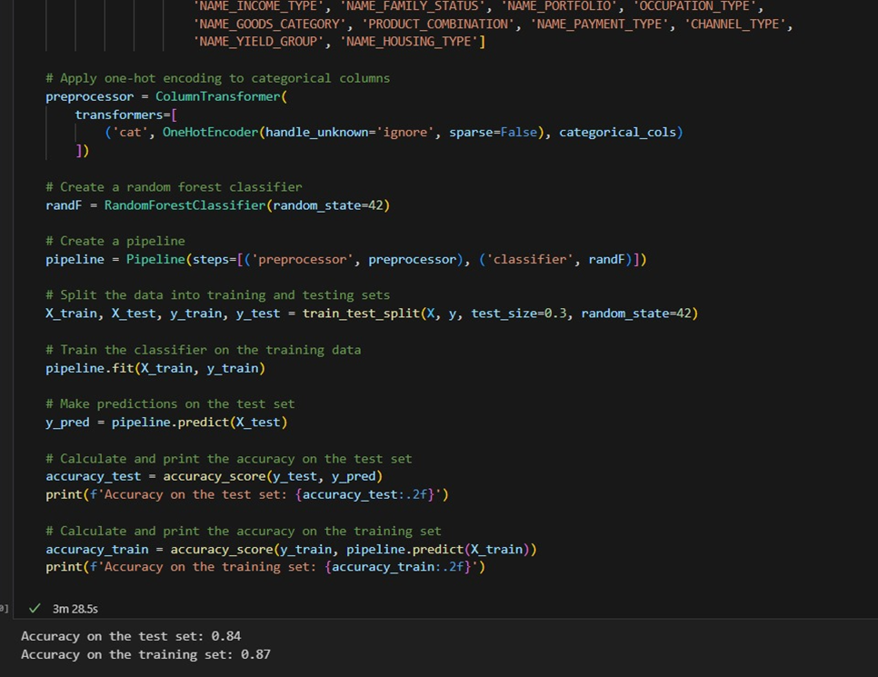
RANDOM FORESTS
We are using random forest to build on the Decision tree model.
The random forest model makes sure that there is no hampering of the data from the decision tree and the decision tree is not overfitting
We get an 87% with training set and 83 % with the test set

Slide 17
CONCLUSION
Meticulous data processing and feature engineering for robust eligibility assessment.
Logistic Regression, Random Forest, and Decision Tree models chosen for their suitability in binary classification tasks.
Commendable accuracy and efficiency in evaluating loan eligibility demonstrated by machine learning models.
Emphasis on careful data preprocessing and feature selection for enhanced model performance.
A foundation for continued exploration and refinement in improving the precision and generalizability of the loan eligibility assessment system.
PREMIUM

Slide 18
THANK YOU

